Slide 1

Advertising and disability activism
Dr Ella Houston
houstoe@hope.ac.uk

Slide 2
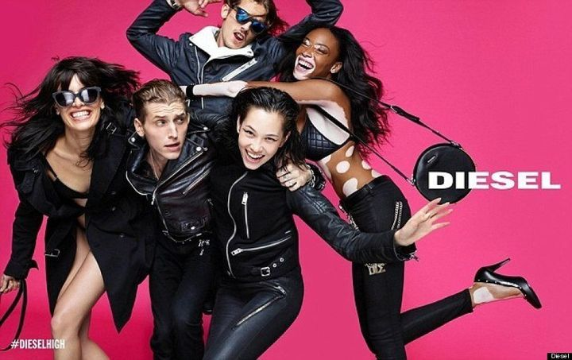
Can I have your attention?
Beauty & Disability
The beauty and fashion industries have long fallen short of diversity and inclusion. But in the era of social media activism, the status quo has started to shift. More and more beauty brands are being inclusive of more body shapes, sizes, and colors. But what continues to be left out is disability representation.
Industry executives are slowly implementing more disability-inclusive practices, such as portraying models with disabilities, including adaptive makeup tools, and incorporating universal design principles. But the beauty and fashion industries still have a ways to go to rectify the longstanding history of disability exclusion (Kim, 2024)

Slide 3
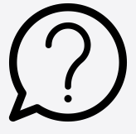
Advertising for social change
Which advertisements do you find most memorable and why?
Billions of people across the globe are exposed to advertisements
Advertising via social media is increasingly prevalent
Advertisements are both persuasive and educational
However, as well as being a powerful tool for social change, advertising can also reinforce the marginalisation of disabled people in society

Slide 4
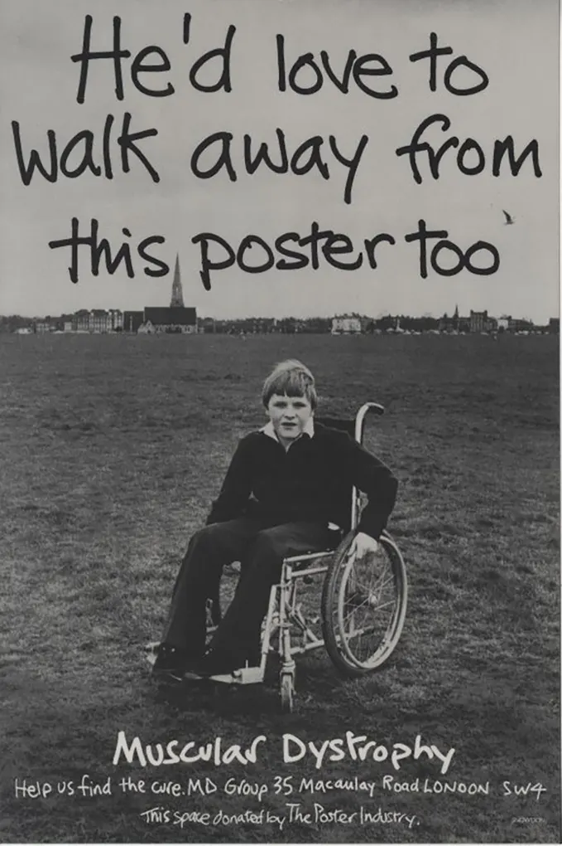
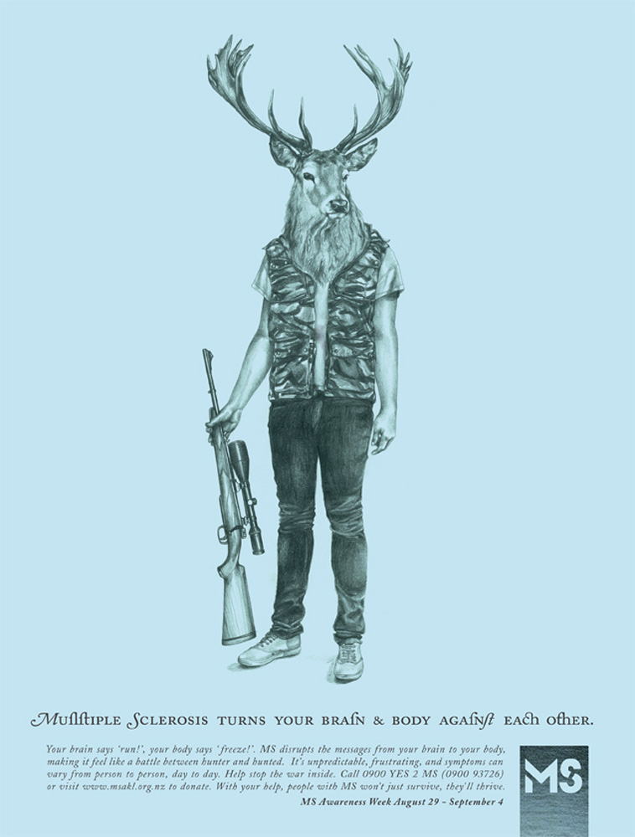

Piss on pity

Slide 5
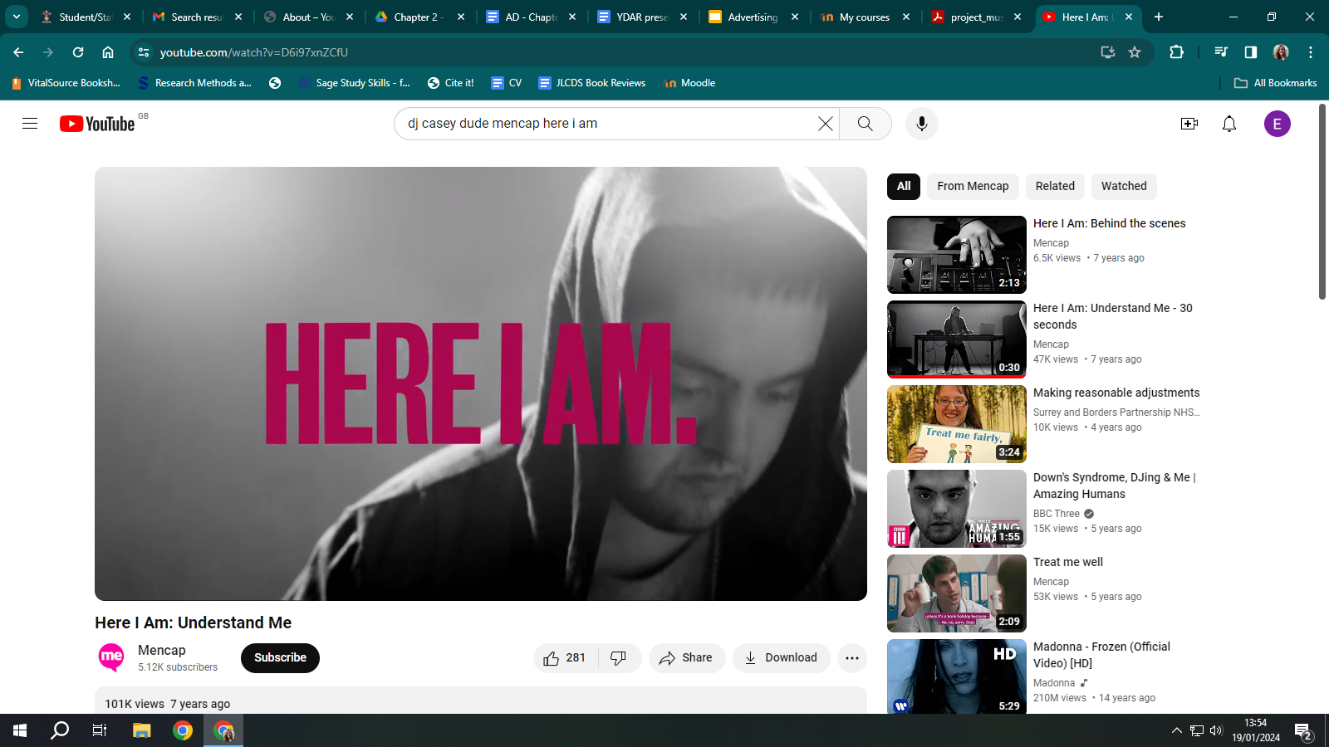
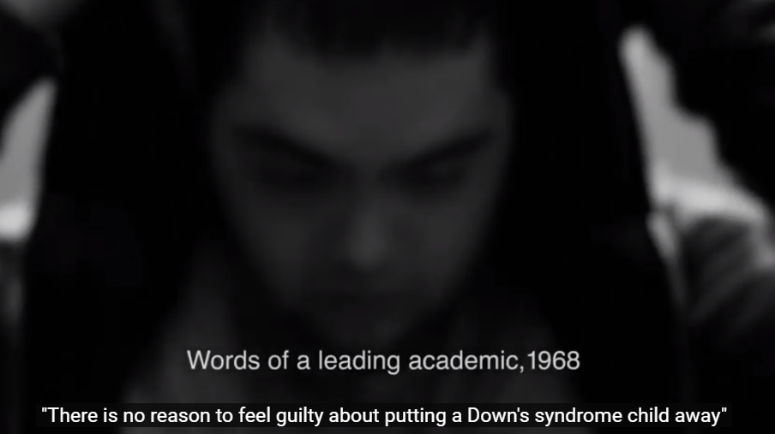
Shockvertising

Slide 6
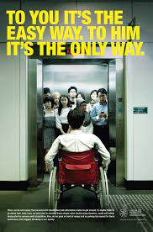
Disability activist shockvertising
Disabled People's Organisations create shocking advertisements in order to educate people about disabling barriers
Bold statements capture people's attention more effectively than lots of information
Shocking advertisements can go viral, sharing activist messages with mass audiences

Slide 7
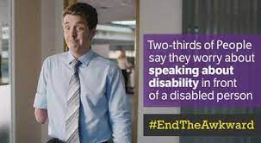
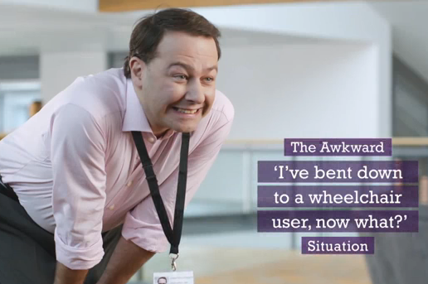
Getting it wrong
"With disability hate crime on the increase, the closure of the Independent Living Fund, the bedroom tax, the assisted dying bill, the cumulative effects of cuts on disabled people and the vilification of disabled people in the right-wing press, why is Scope still banging on about ‘End the Awkward’?" (Hilton, 2015, cited in Pring, 2015: n.p.).

Slide 8
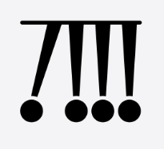
Creating adverts that are impactful - some practical tips
Diversity is key - in terms of who you represent and the audiences you target
Considering accessibility enhances advertising
Use social media to your advantage
Create maximum impact through clear, concise messages
Approach advertisements as an opportunity to promote counter-narratives of disability

Slide 9

Keep in touch
Visit the Centre for Culture & Disability Studies's website
We have a YouTube channel
You can also follow our Facebook page for regular updates on CCDS events
My email address is: houstoe@hope.ac.uk

Slide 10
References
Anand, S. (2022) Advertising as Activism: Exploring an Aesthetics of Debility in Kashmiri Human Rights Campaigns. Journal of Literary & Cultural Disability Studies, 16(4), pp. 457-474.
Grey, F. (2016) Benevolent othering: Speaking positively about mental health service users. Philosophy, Psychiatry, & Psychology, 23(3), pp. 241-251.
Kim, S. (2024) 'Beauty & Disability: The Entrenched History of Ableism in the Beauty Industry'. Available from: https://wid.org/beauty-disability-the-entrenched-history-of-ableism-in-the-beauty-industry/
Leiss, W., Kline, S., Jhally, S., Botterill, J. and Asquith, K. (2018) Social Communication in Advertising (fourth edition). Abingdon: Routledge.
Longmore, P.K. (2015) Telethons: Spectacle, Disability, and the Business of Charity. New York: Oxford University Press.

